Slide 1
v

Slide 2
The difficulty with golf is that it requires a broad range of skills.
You need good technique, brute force off the tee and out of the rough, the most delicate refined finesse on and around the greens, and a solid mental perspective.
Developing all of those attributes really defines success in our sport but unlocking them can be challenging.

Slide 3
How many times have you felt there was no opportunity to practice?
When you did finally get on the range or short-game facility how often have you not known what to do?
When playing have you ever thought your practice did not match your on-course performance?

Slide 4
Everyone has time constraints whether it be school, family, work, etc.
We have a lot going on and golf is a difficult sport with many facets requiring attention to maintain and improve.
Maximizing productivity in practice is a dilemma for those of us loving this sport and wanting to get better.

Slide 5
Preparation is really about efficiency.
Too long is tiring and distracting.
Too short does not meet your objective.
Disorganization clouds your perspective.
Golfers at every level must be efficient when carving out time to practice.

Slide 6
Remember being at the arcade and playing Whack a Mole?
Every time you punched down a mole another one appeared. It’s the perfect analogy for how most players approach their practice.
For instance, say you are struggling with short putts. When you finally get thirty minutes to practice, you dedicate the entire time to hitting putts inside eight feet. Then you move on to the course and close-range putts start dropping! Great, but you then have a problem with contact on your pitch shots – another mole appears! Get my gist?

Slide 7
Practice should not be long or arduous. Really, it should be fun.
Proper preparation involves principles that build consistency in all aspects of your game and healthy perspective in your mind.
Always have a plan and always make a point of working on each segment of the game.

Slide 8
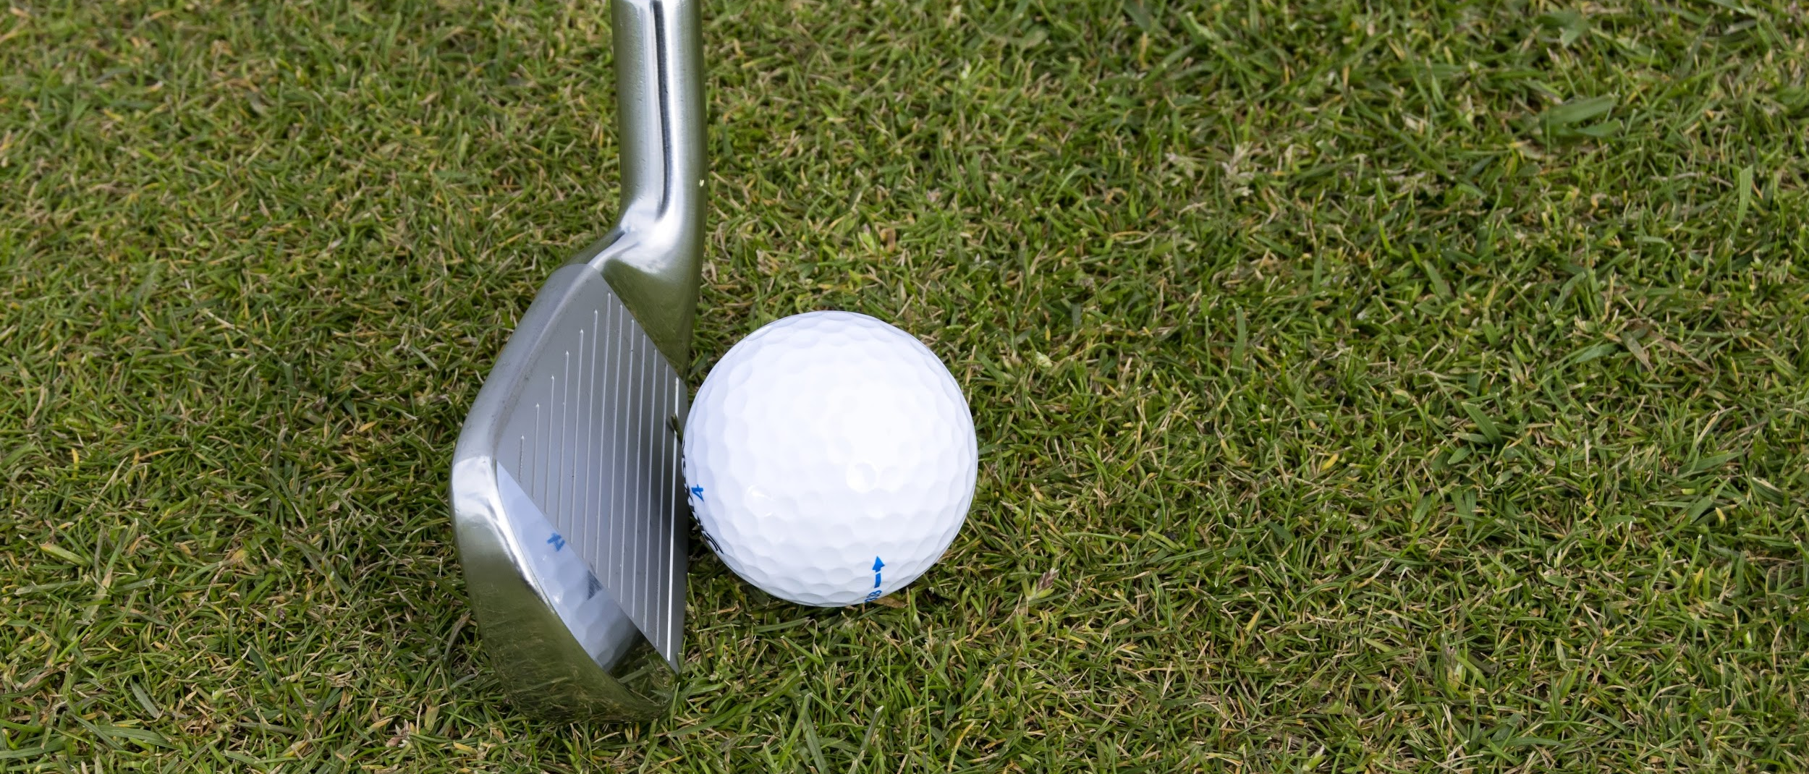
Over-preparing is preparing to fail.

Slide 9
Make good habits. Habits regarding proper practice and positive perspective can shape your life far more than you may realize. Routines grow stronger the more you perform them and they enhance your subconscious guidance system. They create neurological cravings in your brain for more of the same. Those cravings play out in more automatic performance on-course, resulting in improved confidence, resistance to distraction, and of course lower scores.

Slide 10
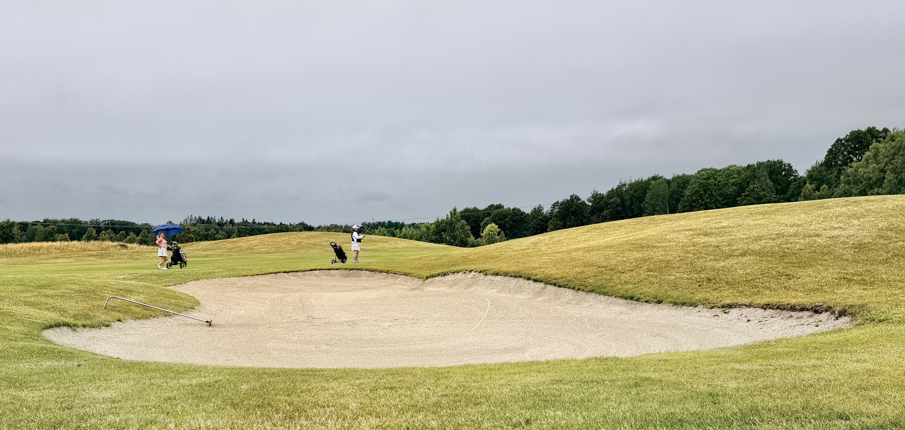
When your practice is comprehensive and concise and you have an unwavering belief in it, unwanted results will not faze you. You will operate from a place of knowing and trusting that good things will happen – and they will.
:

Slide 11
There’s a difference between practicing and warming-up for a round or warming-down after playing. They are very different and the elements should not be mixed.
:

Slide 12
Practice sessions should have the purpose of making changes and improvement.
They should not take place immediately before a tournament round or one where you want to show off your game to playing partners.
They require significant focus and attention for periods of time, which can be tiring and distracting from the focus you need on the course.
If you want to practice before an important day on the course, complete it hours before your tee time. Give yourself an opportunity to leave the range for a lengthy break to get some food or just rest in the clubhouse and then go back out to do your pre-round warm-up. This approach will allow your body and mind to reset.

Slide 13
A warm-up routine is exactly what it sounds like – you are just trying to warm up your body and mind.
There should not be a lot of technical thought. You are operating from a place of competence, knowing you have already put the work in.
Now it is time to have fun. Hit a big hook, a slice, a flop shot, or an 80-foot putt – anything that gets your muscles and nervous system going.
Hit shots you might need that day on the course. If it is windy, hit some low punch shots. If it is firm and fast, hit some high soft cut shots with your irons.

Slide 14
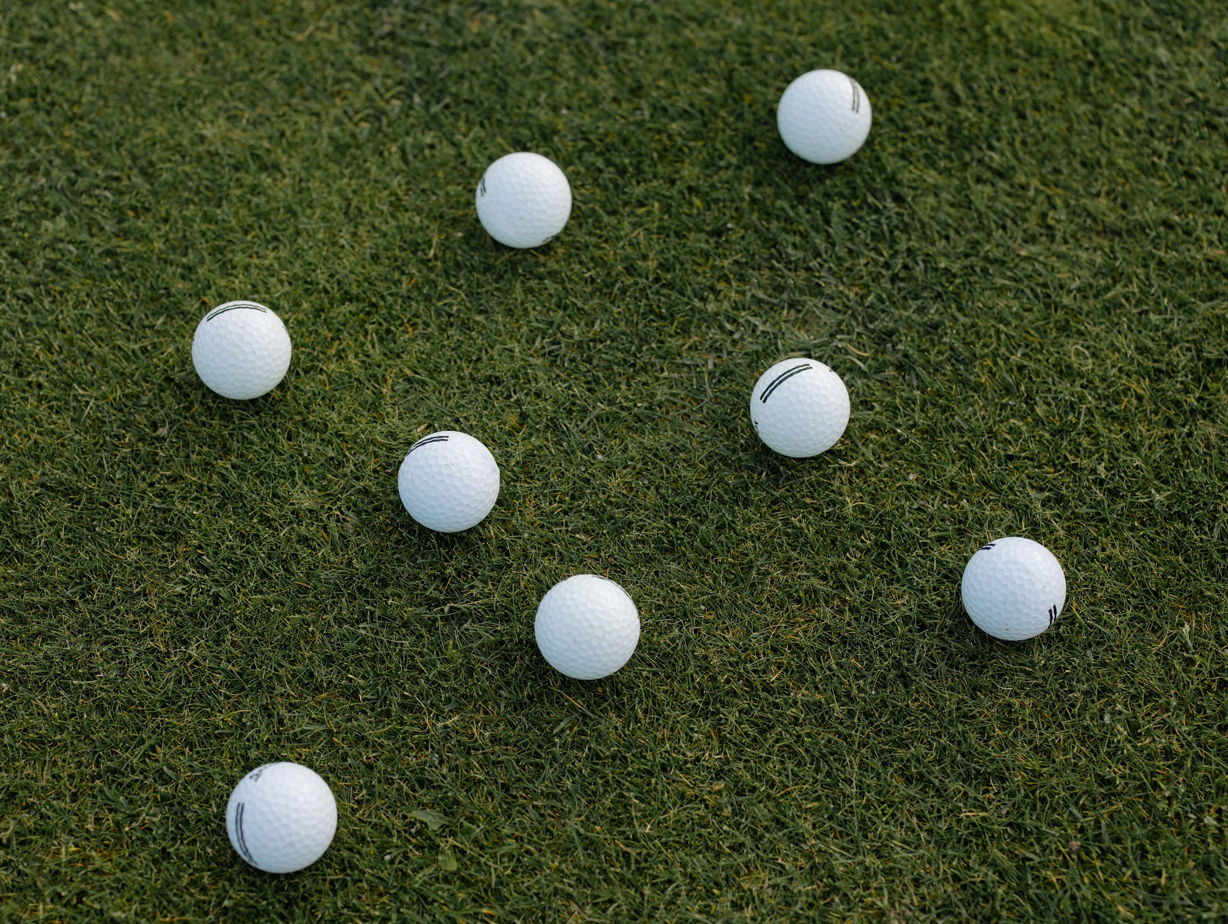
There are four key physical areas of golf: putting, short game (pitching, chipping, and bunker play), distance wedge play (shots between 30 and 130 yards), and full swing (driving and iron play).
The goal during a practice session is to spend equal amounts of time and energy on each area. Even if you are struggling mightily with one specific part, try to resist the temptation to dedicate a disproportionate amount of time to it.
Remember, golf is an all-encompassing sport. Treating each area equally is the best way to build consistency, flow and feel.

Slide 15
Repetition of your preparation program primes your unconscious behavioral guidance system, which usually knows the cause of something that is amiss.
It then sends a message to your conscious mind to make an adjustment.
This guidance system is sophisticated and adaptive, and you just need to feed it the proper routines to allow it to work!

Slide 16
Your unconscious mind is enormously powerful! It calls out fixes every day.
Say, for example, you walk into your weekly staff meeting or class and your mind immediately tells you that something is different than normal--maybe the atmosphere is happier. Your unconscious guidance system tells your consciousness that you need to be a bit more upbeat to match your colleagues.
That same kind of call out occurs in golf when things break down. The fuel for it happening is routine.

Slide 17
The two most important times in your day are just before you go to sleep and just after you wake up. These are your “bookends,” and if you learn to master them you will quickly gain greater control in your life.
They are great times to visualize good practice and well-struck shots. The mind does not know the difference between what is real and what is imaginary. If you imagine hitting a golf shot in your mind with great detail, the same neural pathways fire as if you are hitting that physical shot.
Incorporate as many of the senses as possible. What is the temperature? How does the club feel in your hands? What sound does impact make when you connect with the ball? Use color as well. See the flight of the ball against a sky that is your favorite color.
If you start to bookend your days with detailed visualization, you will be surprised how it improves your results!

Slide 18
Routine is how you build mental memory and the kind of intention that creates inner confidence.
It does not matter how many times you have failed in the past. It does not matter how messy or conflicted your life may be.
You can develop confidence quickly by repetitive practice, allowing your subconscious to self-correct and your consciousness to feel positive flow.

Slide 19
Chipping, Pitching and Bunker Play:
Over the past twenty years the PGA Tour player who has led the greens in regulation statistic has averaged between 71% and 77%. That means the best ball-striker in the world still misses on average four to five greens per round. So, the finesse part of the game involving chipping, pitching, and bunker play is crucial.
Short game is completely different than full swing. In full swing, you want to generate power and resulting compression on the ball with it rocketing forward and landing in a general area where you may not be able to predict run out. Conversely, in a finesse shot, you plan to have the ball come out softly and anticipate roll.

Slide 20
Distance Wedge Play:
Distance wedges between 30 and 120 yards can be awkward because these shots are longer than a finesse shot but shorter than a full swing. It is important to work with your instructor on establishing a technique that produces consistent contact. Feel can develop only if you make contact with the ball in the same way almost every time.
Most better players hit these shots low with a lot of spin. This kind of trajectory will give you the most control. If someone asks you to toss them a ball, you would not throw it overhand way up in the air because height makes it too hard to judge distance. It would be better to toss it to the target underhand with a boring flight.
Another key fundamental for distance wedges is to vary swing lengths to produce different flights and distances. This approach may seem a bit technical but it is important to have a reference point when hitting these awkward, in-between yardages. Too many people struggle, relying solely on feel for how far they hit their wedges.
You should develop two “standard shots” for each wedge – a swing back to 9 o’clock where my left arm is parallel to the ground and a shorter swing where the end of the club points to my belly button.

Slide 21
Full Swing:
When you arrive on site, set up a station to video your swing, do a little warm up, and then record shots. Make sure your camera is stationary (balanced on your golf bag or a tripod) and film from the same location every time. Camera angle is very important because out-of-line views will distort what you see. For down-the-line clips, set the camera waist high, pointing at the target between your feet and ball (through your hands at address). For face on, again focus it waist-high so you can see the club throughout the clip.
Full-swing technique is the most complex because there are so many moving parts.
Some players like to do a little technique work at home in front of a mirror and the remainder at the course.

Slide 22
Putting:
Technique work is also called block practice. This is the only time you should be hitting the same shot over and over. The key is to understand what your tendency is – this should be worked out earlier with your instructor – and check it through feedback using video, drills, or observation of ball flight and then move on. Most people spend way too much time in this phase. Once you have a handle on your technique, it is time to move to random practice followed by competitive games.
After the technique check is finished, move on to random practice which involves never hitting the same shot twice. If you intend to replicate a shot in practice, be sure to change clubs, trajectory, shot shape or line (especially in putting). Golf is a game of adaption as each shot is individual and unique, and your goal is to recreate this distinctiveness in practice. You are training your mind and body for course conditions.
Lastly, finish each phase of practice with some form of competition. There are consequences on the golf course when you hit a shot where you did not intend, and you must simulate them course conditions on the range. Competitive games in practice can be against yourself or with someone else. They will strengthen your ability to hit committed shots on the golf course.
All aspects of golf are important, but you will use your putter far more than any other club – almost half of the time. Lots of golfers believe great putters are born and you either have the talent or you do not, but I disagree. Putting is an art that you can learn if you understand how to practice effectively.
There are three primary skills when it comes to putting: starting the ball online, controlling speed and green reading. In a proper training session, all three of these areas should be addressed.
A quick technique check, followed by random practice and lastly competitive games are the foundation for your preparation.

Slide 23
You can deviate from this uniform preparation approach occasionally, however.
There may be times when, say, putting is so far from where it should be that you need to say to yourself “I am going to set aside an hour for work on greens only.”
However, if you’re serious about improving you need to have structured practice with equal focus on every aspect of the game. Do not make too many exceptions!

