Slide 1
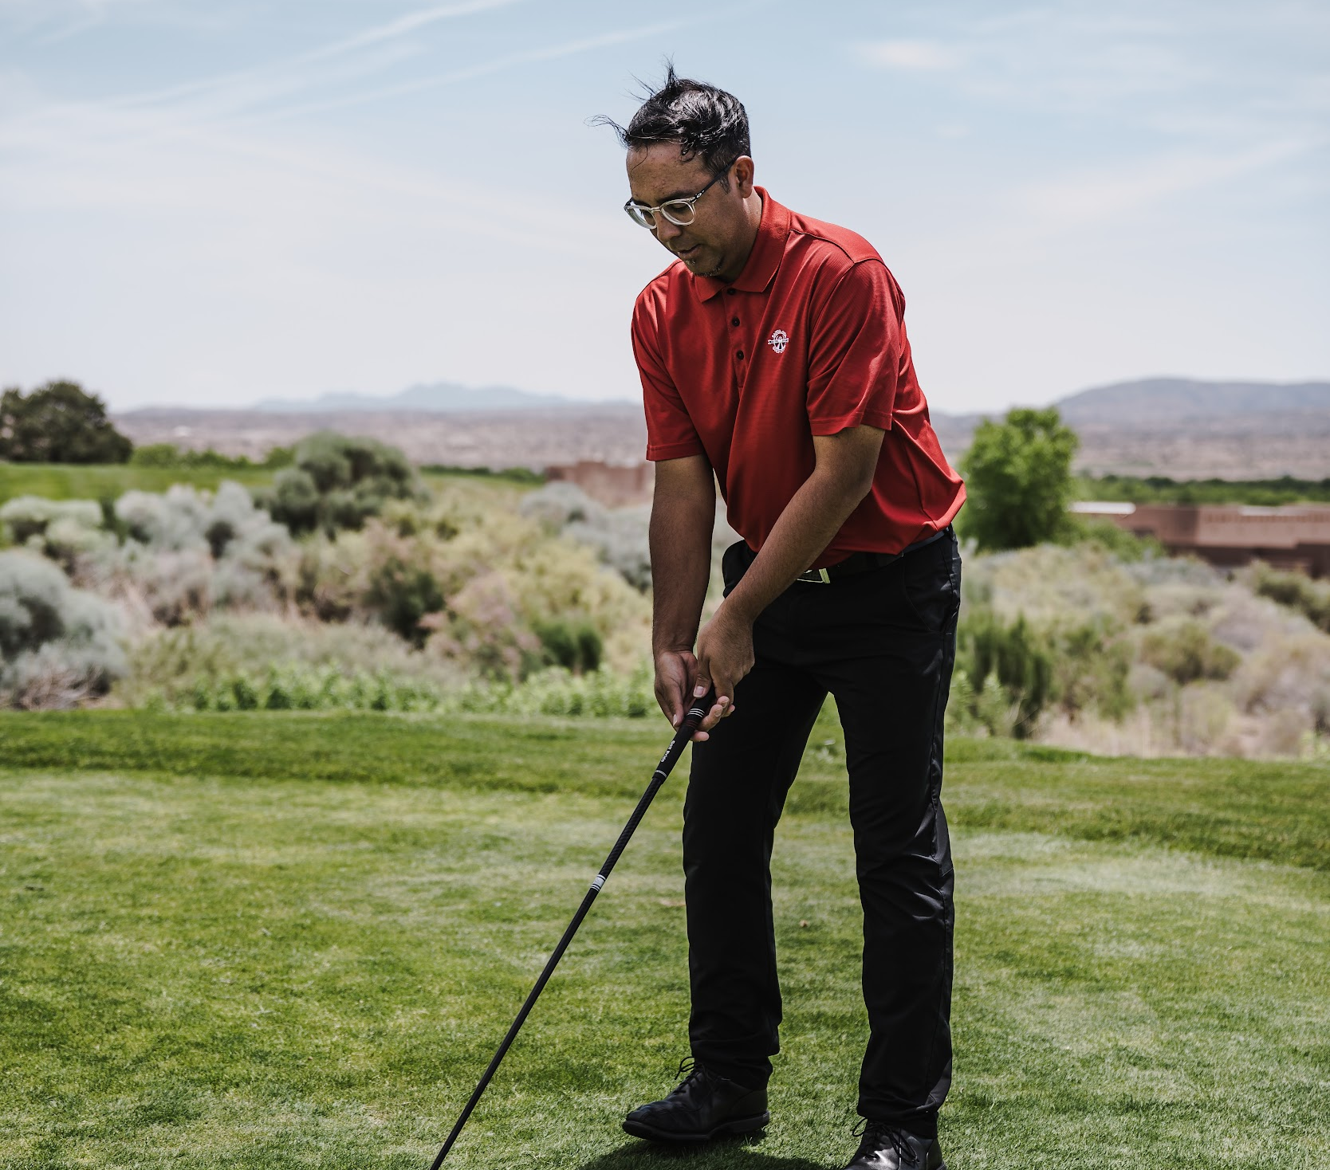
v

Slide 2
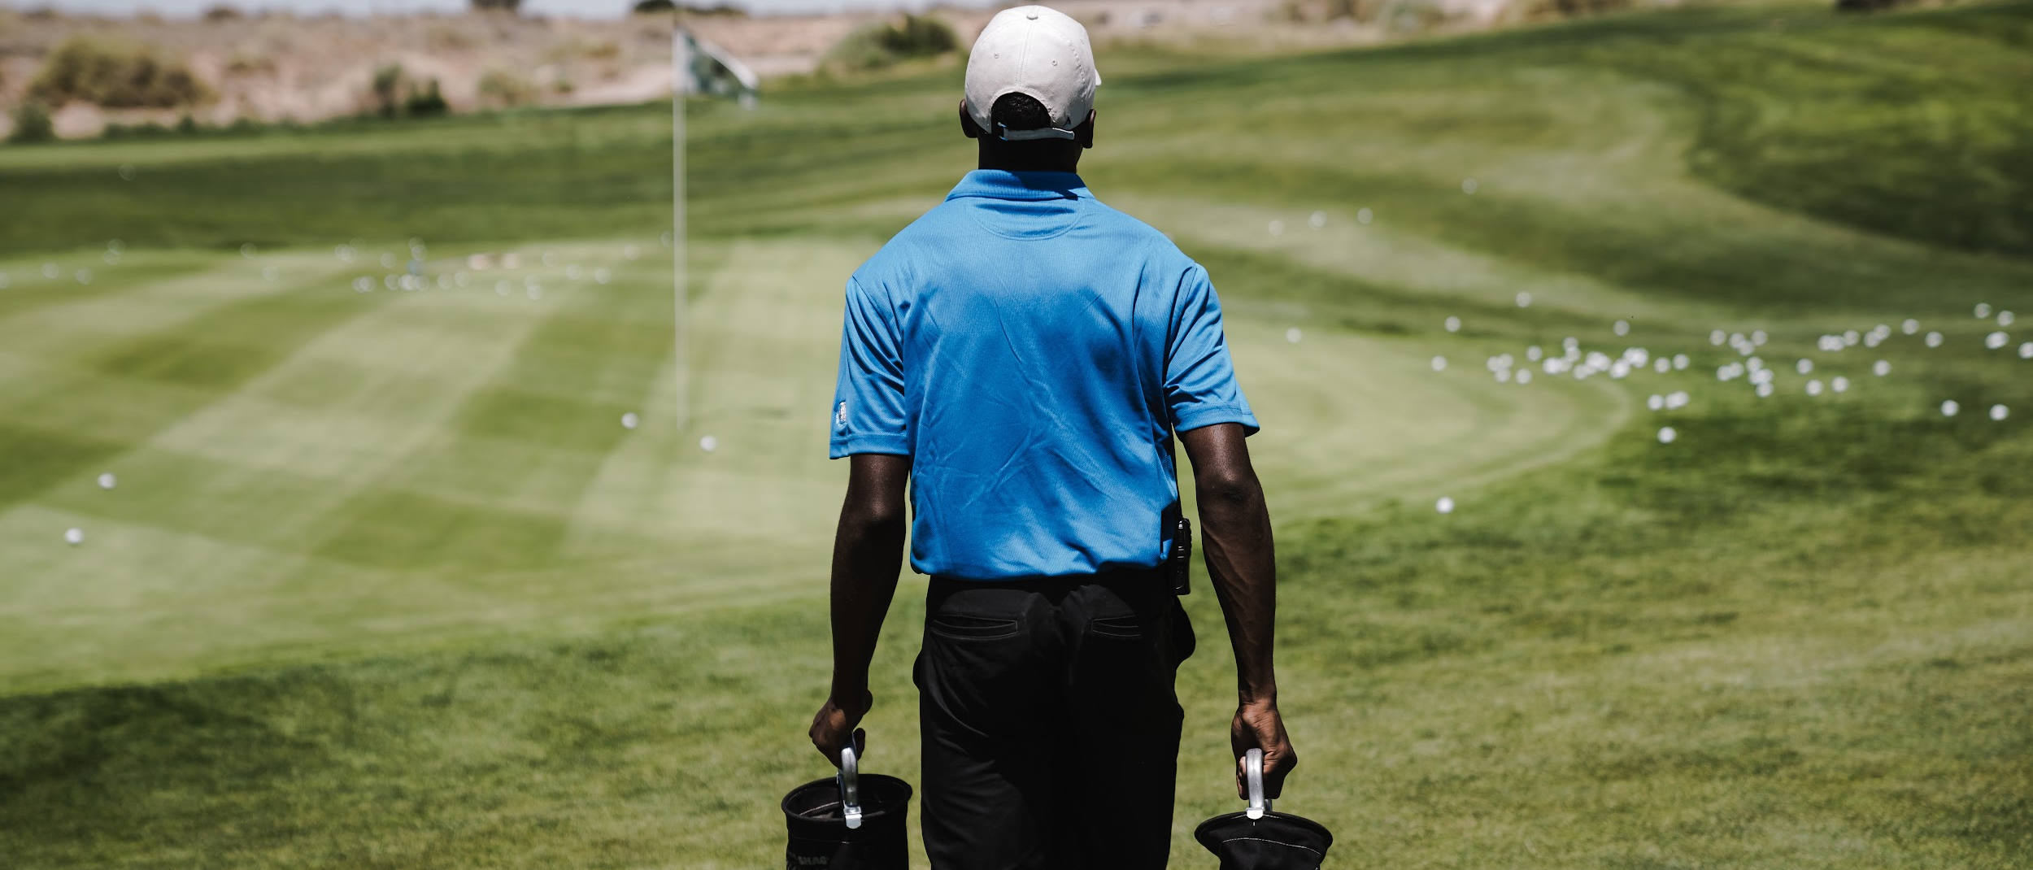
Golf has a rich history of decorum. It offers formality, politeness, and an opportunity to show character. It encourages socialization, teaches good manners, and promotes awareness and safety. Learn etiquette so you don’t stick out like a sore thumb.

Slide 3
On the First Tee:
Wear appropriate attire.
Turn off your cell phone or place it on silent and try not to use it.
Check the scorecard to learn any local rules.
Count your clubs as you’re allowed only 14.
If you're playing companions suggest a match, make sure everyone understands the format and you’re comfortable with the stakes. Negotiating match terms is fine – and fun!
Place an identifying mark on your ball and inform the other players of the type and number ball you are playing.

Slide 4
On the Course:
•
Lowest score on the previous hole tees off first.
•
Learn the meaning of golf terms, such as ace, albatross, eagle, birdie, par, bogey, double bogey, short-side, mulligan, chunk, thin, gimme, scramble, flop shot, shank, slice, hook, snowman, waggle, loose impediments, ground under repair, and casual water.
•
Don’t swing your club until you know others in your group are at a safe distance. Likewise, keep your distance when others are swinging.
•
Player furthest from the hole goes first, including on the green.
•
When practicing your swing, never swing in the direction of another player. There may be pebbles or twigs or other matter in the grass that could fly up and strike a playing partner.
•
Stand still and be quiet while others are hitting their shots.
•
Follow cart path rules.
•
Don’t ask for advice or give advice.
•
Don’t place golf bags on tee boxes or greens.
•
Don’t hit the ball until you are certain that the group ahead of you is out of range.
•
Don’t practice on the course.

Slide 5
Avoid Slow play:
If your group is walking and there are 3 or 4 of you, send the first person to putt out to the next tee box. If you’re in a foursome, also send the second to putt out to the next tee box. The second to last person to putt out should replace the flagstick. This practice can save 30 minutes over an 18-hole round.
It’s extremely rude to not let a group play through that is waiting on yours. The one exception is if you’re also waiting because of the group in front of you. If this is the case, you should make this known to the group behind you.
Walk at a reasonable speed between shots.
Don’t sit in a cart while your playing partner is hitting. Whether you’re walking or riding the course, begin planning your next shot as you approach the ball by getting yardage, selecting club and studying lie, wind, and terrain.
When it’s your turn, evaluate your shot, visualize your swing and shot, go through your pre-hot routine and then hit it.
From the time you select your club until you actually hit your shot, you should take no more than 30 to 45 seconds.
If you aren't ready to play when it’s your turn, encourage one of your fellow players to hit.
If you’re new to the game, set a stroke limit of 8 for each hole. Once you get to that number, pick up your ball and place it on the green and finish the hole from there.
Write down your scores on the next tee box – not on the green.
Park your cart/golf bag on the side of the green toward the next hole.
Limit the amount of time spent at the turn (between holes 9 and 10) or let the group behind you play through.
Limit practice swings to 2. You’ll be surprised at how much time practice swings add to a round of golf.

Slide 6
Maintain the course:
Replace your divots, but if turf explodes and fragments:
If your ball lands in a bunker:
Repair any pitch mark or indentation caused by your ball hitting the green.
Bring a rake into the bunker with you
Enter the bunker from the low side at a point nearest to the ball.
Whenever possible, avoid walking on the steep face
After hitting your shot, rake the area you played from, as well as all your footprints and smooth out any other imperfection.
Rakes should be left either just inside or nearby the bunker.
Use any available container of soil/seed mixture to fill the divot.
Use the toe of your shoe to kick in the edges of the divot.
Use a tee, knife, key or repair tool
Repair the mark by working the edges towards the center, without lifting the center of the mark. Don't tear the grass. Finish by smoothing the area with a club or your foot. Try to get the area smooth enough to putt over.

Slide 7
While on the green:
Make sure you don't stand on anyone's line.
Hold the flagstick at arm's length and don’t allow the flag to flutter in the breeze
Make sure your shadow doesn't fall across the hole or line.
Loosen the bottom of the flagstick so it doesn't stick when you try and remove it
Pull the flagstick straight up after the other player has putted.
If you lay down the flagstick, place it off the green to prevent doing any damage.
After everyone has putted out, immediately walk to the next tee.
•
Don't step on your fellow players’ putting lines – which is the imaginary line that connects the ball to the hole.
•
Don’t stand where you might distract a fellow player and stand still when a player is hitting – don’t move.
•
•
•
Don’t stand directly behind someone or directly in front
•
Don't make any noise when your fellow player is preparing to putt and be certain your shadow doesn’t cover his or her line of putt.
•
•
•
If your ball is on a player's line, volunteer to mark it with a plastic marker or a small, thin, dark coin such as an old penny. Shinny coins can reflect too much sunlight.
•
Don’t practice on the course.
•
If you don't have a caddie, be aware that you may need to tend the flagstick. Generally, the player closest to the hole will manage it. While doing so:
•
•
If your ball is not furthest from the cup (such that it’s your turn to play), mark it and clean it.

Slide 8
If you hit a tee shot into the woods and suspect it might be either lost or out-of-bounds:
You then have three minutes from the time you reach the spot where you suspect the ball landed to find the ball. If it is not found within that three-minute period, you must declare it lost and play your provisional ball with applicable penalty.
At the end of the round, shake hands with your fellow players, congratulate the winners, and thank everyone for their company. One of the great pleasures of golf is spending with friends on the course.
For safety's sake, never hit when there's a chance you might be able to reach the group ahead of you, and anytime you hit a shot that you think has even a remote chance of hitting any other players, yell "Fore" immediately. Make a point of apologizing to any players your ball lands near.
Play a second or provisional ball.
Displays of frustration are one thing, but outbursts of temper are quite another. Yelling, screaming, throwing clubs or otherwise making a fool of yourself are unacceptable and may get you removed from the course. They can even be dangerous to yourself and others.

